Slide 1

Product Spotlight
Alistair Garrison
Director of Accessibility Research
Zahra Safavian, VP of Product
October 3, 2017
This webinar is scheduled to begin at 2pm Eastern / 11am Pacific
Audio is provided through the webinar platform via your computer’s speakers, or there is an optional conference line: (805) 309-2350, Code: 14930# (please note this is a toll call)

Slide 2
Webinar Features
Real-time Captioning: Captions are provided in the captioning pod (upper right). In the event we experience any issues with the pod, we will ensure that the recording of today’s session is closed captioned.
Questions: Time will be provided at the end of the webinar for questions. Please submit questions via the Chat pod – (Keyboard: Ctrl + Semicolon)
Today’s Session is Being Recorded: Link to slides, recording, and transcript will go out via within a few days.
levelaccess.com | (800) 899-9659 | info@levelaccess.com

Slide 3

Introduction
Alistair Garrison
Director of Accessibility Research
16 years experience - auditing websites, and developing support tools.
W3C/WAI – Participant: Formerly Evaluation Methodology Task Force, and now the Accessibility Conformance Testing Task Force.
levelaccess.com | (800) 899-9659 | info@levelaccess.com

Slide 4
Introduction
Zahra Safavian
Vice President of Product
20 years of UI/UX and Product Design
15 years of Product Management
Running product teams and managing the product development process at companies in the education technology space -- Blackboard, Learning Objects, Starfish Retention Solutions
levelaccess.com | (800) 899-9659 | info@levelaccess.com

Slide 5
First things first…
Quick overview of ACCESS Engine, Level Access’s stand-alone checking library…
levelaccess.com | (800) 899-9659 | info@levelaccess.com

Slide 6
ACCESS Engine…
Coded entirely in standard JavaScript (ES6/2015, transpiled to ES5), using the standard JavaScript platform – no dependencies on JS frameworks.
Exposes a selection of APIs which allow all tests to be run, single tests to be run, etc.
Can be run on any page DOM state; no visible footprint left in DOM.
Uses optimized JavaScript + enhanced CSS selectors in the testing process to ensure that test run super fast! As we also don’t have time to waste…
levelaccess.com | (800) 899-9659 | info@levelaccess.com

Slide 7
ACCESS Engine, now in all our tools…
AMP Toolbar;
AMP Spider;
Alchemy;
Access Analytics…
levelaccess.com | (800) 899-9659 | info@levelaccess.com

Slide 8
Consistent results…
Same engine.
Gives highly consistent results across all our products…
levelaccess.com | (800) 899-9659 | info@levelaccess.com

Slide 9

However, if you understand Accessibility testing is…
Effectively an extension of User Acceptance Testing (UAT).
Ensuring:
Users – including defined groups of disabled & older users;
Using – defined assistive technologies, browsers, and operating systems;
Can – effectively and efficiently undertake necessary journeys within a product (e.g., web site or web application);
To – complete all core goals.
levelaccess.com | (800) 899-9659 | info@levelaccess.com

Slide 10
Then, you understand that…
We have moved past simply putting the url of a page into an on-line tool; and pressing test – in order to check:
The source code; or
The initial DOM state of the page (post-load).
Although this is still a useful approach when sampling, as part of a Quality Improvement process.
levelaccess.com | (800) 899-9659 | info@levelaccess.com

Slide 11
ACCESS Engine’s Potential
And, as such we saw the great potential of including our highly integratable “ACCESS Engine” in our own Continuous Testing practices…
Building on, and greatly extending the Accessibility Testing coverage we already get through using AMP / ACCESS Analytics, etc.
levelaccess.com | (800) 899-9659 | info@levelaccess.com

Slide 12
FYI - Continuous Testing…
Continuous Testing (CT) is the process of executing automated tests within areas of the software delivery “conveyor belt” in order to find and remove bugs at the earliest possible point…
CT can be done at lots of testing points, but we were focusing on the integration of ACCESS Engine into the CT activities we already had hooked into Continuous Integration (CI).
levelaccess.com | (800) 899-9659 | info@levelaccess.com

Slide 13
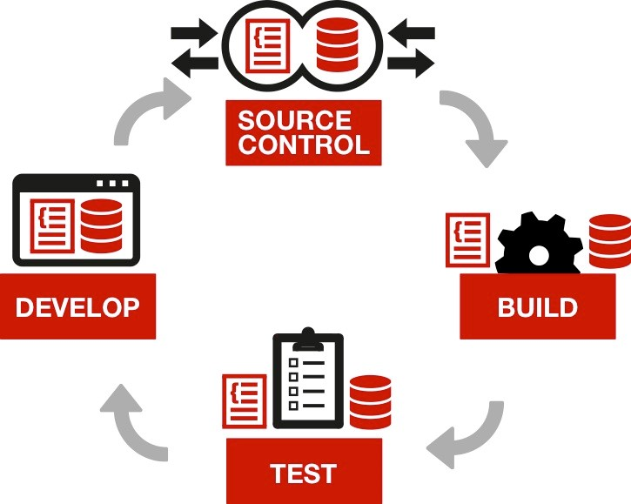
FYI - Continuous Integration…
Continuous Integration (CI) is a development practice;
It requires developers to check-in their code to a shared repository – ideally several times a day.
Each check-in forces an automatic re-build; then re-test of the software (from the integrated code)
So integration issues can be detected immediately.
levelaccess.com | (800) 899-9659 | info@levelaccess.com

Slide 14
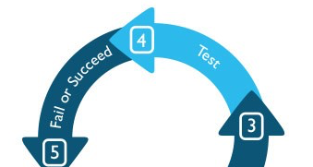
For us, CT in CI looks like…
On code commit:
CI runs all unit tests (fast);
CI runs a smoke test of BDD (Behaviour Driven Development) tests (slow);
tests that cover the highest traffic tasks / journeys;
happy paths;
Nightly:
CI runs all BDD tests.
Unit Tests
Test type
Smoke Test
Nightly
Number of tests
levelaccess.com | (800) 899-9659 | info@levelaccess.com

Slide 15
ACCESS Continuum arrives…
With the benefits of the integration of ACCESS Engine into our Continuous Testing practices becoming quickly apparent, such as:
Massively increased content coverage being tested for accessibility, with each stage in full journeys able to be separately tested; and
Once setup and running in CI, it acting as an effective guard against new accessibility issues creeping in;
We wanted to extend the opportunity to our customers – and ACCESS Continuum was born.
levelaccess.com | (800) 899-9659 | info@levelaccess.com

Slide 16
ACCESS Continuum arrives…
Currently, ACCESS Continuum is the term we use for the integration of ACCESS Engine with test automation frameworks (initially Cucumber, Jasmine / Karma – as that’s what we use); enabling ACCESS Engine’s rich set of accessibility tests to be run on a code snippet, a node in a rendered page, a fully rendered page, etc...
levelaccess.com | (800) 899-9659 | info@levelaccess.com

Slide 17
ACCESS Continuum…
The ability of test automation frameworks to simulate user interaction with content means that all content states can be tested for accessibility through ACCESS Continuum – so you can now be confident that every step in a task is being automatically tested for accessibility.
In time, we hope ACCESS Continuum will grow to become a collective noun – covering all the integration opportunities we’ll undoubtedly find for ACCESS Engine, because as we’re already seeing ourselves, it’s a rather integratable accessibility testing engine.
levelaccess.com | (800) 899-9659 | info@levelaccess.com

Slide 18
ACCESS Continuum flavors…
ACCESS Continuum initially includes 3 example projects, but we’re looking to grow that number aggressively.
These first 3 projects illustrate how we’ve integrated ACCESS Engine into our own unit testing / BDD testing.
Initial Project Flavors are:
(JavaScript) Jasmine / Karma
(JavaScript) CucumberJs / Selenium / Continuum.js
(Java) Cucumber / Selenium / Continuum.java
levelaccess.com | (800) 899-9659 | info@levelaccess.com

Slide 19
ACCESS Continuum flavors…
All of these projects test web content. Noting, that the Continuum.java file is there for those writing their BDD tests in Java (as we’ve started to do), when they are testing web content.
All of these projects include the Community edition of ACCESS Engine, which is a free version of Access Engine that includes a good number of fully automatic tests – however, a more comprehensive version of ACCESS Engine (with loads more automatic tests) is also available through license.
levelaccess.com | (800) 899-9659 | info@levelaccess.com

Slide 20
Helper files…
For BDD testing we’ve created a helper file – Continuum.js (JavaScript) / Continuum.java (Java) – to make including ACCESS Engine tests in a project simple.
As we broaden the number of integrations of ACCESS Engine with other QA Testing Frameworks, we expect further Helper files might be necessary.
But, we’d like to note that these helper files are a very simple affair to create, as they all create/build a similar Continuum object in a project - with the exact same interface.
levelaccess.com | (800) 899-9659 | info@levelaccess.com

Slide 21

So, what’s it look like?…
levelaccess.com | (800) 899-9659 | info@levelaccess.com

Slide 22
ACCESS Engine API functions…
ACCESS Engine exposes a number of API functions, but we tend to use two main ones in our own tests:
runAllTests_returnInstances_JSON(): runs all automatic tests and returns the results array as a JSON string.*
runAllTests_returnInstances_JSON_NodeCapture(targetNode): runs all automatic tests on the targetNode and returns the results array as a JSON string.*
*For testing, we then convert that JSON back into an array.
levelaccess.com | (800) 899-9659 | info@levelaccess.com

Slide 23
In Unit Testing with Jasmine / Karma…
We use the jasmine-jquery plug-in for karma (although ACCESS Engine is not actually written in jQuery) to enable HTML components to be loaded into an iframe through Karma.
We then simply include the ACCESS Engine Community file in the test folder (no Continuum.js helper file necessary) to automatically make the ACCESS Engine object (LevelAccess_AccessEngine) available in our unit tests.
Once available it just needs to be directed to the window being tested (e.g. in our case the iframe’s contentWindow), before calls are made to the “runAllTests_returnInstances_JSON_NodeCapture(targetNode)” API function.
levelaccess.com | (800) 899-9659 | info@levelaccess.com

Slide 24
In Unit Testing with Jasmine / Karma…
We tend to only use the “runAllTests_returnInstances_JSON_NodeCapture(targetNode)” API function in our unit tests as we want to just test the contents of the HTML widget under test – rather than the contents the whole page content of the test harness window (e.g. the iframe).
levelaccess.com | (800) 899-9659 | info@levelaccess.com

Slide 25
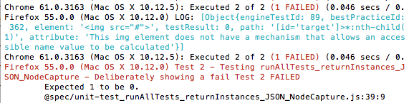
In Unit Testing with Jasmine / Karma…
In addition, we add additional reporting into our unit tests so that we are informed about the details of any accessibility issues located through an ACCESS Engine test.
levelaccess.com | (800) 899-9659 | info@levelaccess.com

Slide 26
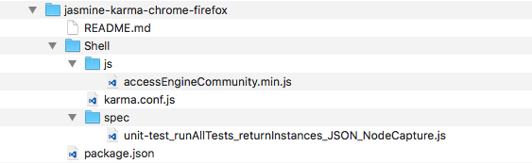
Jasmine / Karma project folder…
levelaccess.com | (800) 899-9659 | info@levelaccess.com

Slide 27
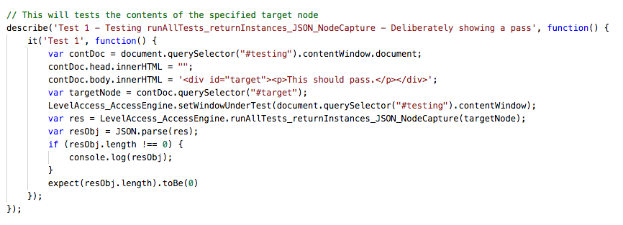
Jasmine / Karma unit test…
levelaccess.com | (800) 899-9659 | info@levelaccess.com

Slide 28
In BDD testing with Cucumber…
When using ACCESS Engine with the Cucumber BDD framework, the Continuum helper file is required. Both currently available flavors of this file (Java / JavaScript) expose the same small set of API functions.
setUp(WebDriver webDriver, String locationPath): you set the webdriver to the webdriver flavor your using, and set the local project location path to ACCESS Engine Community edition (typically in a resources folder).
runAllTests_returnInstances_JSON(): calls the equivalent API function in ACCESS Engine Community edition.
runAllTests_returnInstances_JSON_NodeCapture(String cssSelectorForNode): calls the equivalent API function in ACCESS Engine Community edition.
getA11yResults(): gets the results from ACCESS Engine as an array object of failing instances, collected together with the test id of the test they failed, and other relevant details.
levelaccess.com | (800) 899-9659 | info@levelaccess.com

Slide 29
In BDD testing with Cucumber…
As an example, a typical Gherkin BDD test would look like:
Feature: Test a web page for accessibility
As a QA Tester
I want to open the url https://www.levelaccess.com/
So that I can test its different states with automatic tests in the Community version of ACCESS Engine
Scenario: Run all automated accessibility tests on the specified web page in the page load state
Given the web page "https://www.levelaccess.com/" is displayed.
And the Community version of ACCESS Engine is set-up.
When I call the Community version of ACCESS Engine's "runAllTests_returnInstances_JSON" API function.
Then no accessibility issues are found.
levelaccess.com | (800) 899-9659 | info@levelaccess.com

Slide 30
In BDD testing with Cucumber…
We use the power of the test framework to get content, in a lot of cases web pages or views, to the right state before we call the appropriate ACCESS Engine API function – and simply check that no issues have been found.
levelaccess.com | (800) 899-9659 | info@levelaccess.com

Slide 31
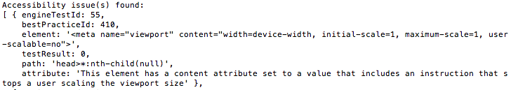
In BDD testing with Cucumber…
The error message shown (below), if issues are located, also includes the failing instances found by ACCESS Engine.
In our own internal processes, if the last statement “Then no accessibility issues are found.” is not correct the CI sends out the dreaded “build failed” email! – at least in new projects.
levelaccess.com | (800) 899-9659 | info@levelaccess.com

Slide 32
In BDD testing with Cucumber…
You will also note:
The “And the Community version of ACCESS Engine is set-up.” step. This is needed when the Continuum helper file is used, as it allows the Continuum file to be told the location of the ACCESS Engine Community edition file within the project, and load it into the page under test.
The “Then no accessibility issues are found.” step. For convenience when BDD testing the results from a call to either API function are stored in a results object. This object can be retrieved in this step – through the “getA11yResults” API function, and examined in the normal manner through expect statements.
levelaccess.com | (800) 899-9659 | info@levelaccess.com

Slide 33
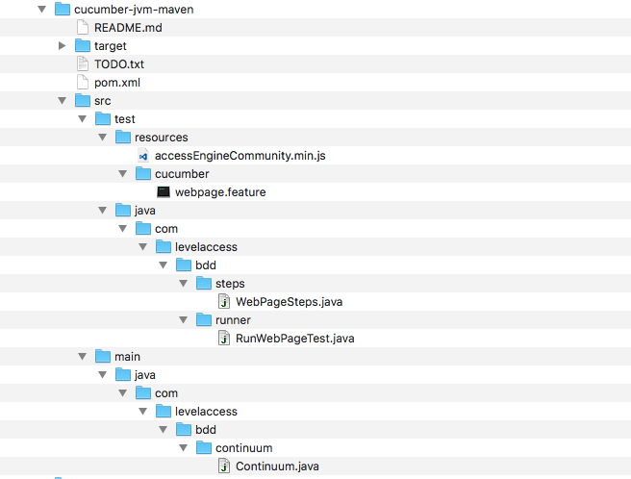
Cucumber (Java) project folder…
levelaccess.com | (800) 899-9659 | info@levelaccess.com

Slide 34
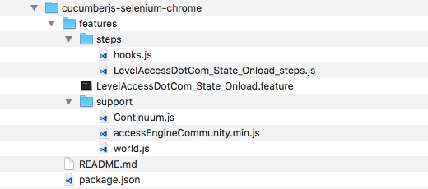
Cucumber (JavaScript) project folder…
levelaccess.com | (800) 899-9659 | info@levelaccess.com

Slide 35
Final note…
Accessibility Testing
When we integrated ACCESS Engine with the QA Frameworks we were using for BDD (Behaviour Driven Development) Testing, and Unit Testing…
We quickly understood that we already had all the coded tests needed to automatically move our web content / pages through the different DOM states in tasks – in the form of our existing BDD tests; or Unit Tests.
So we could quickly build on this previous work, to move to complete Accessibility Testing coverage of the tasks covered in our products.
levelaccess.com | (800) 899-9659 | info@levelaccess.com

Slide 36
Of course…
Accessibility Testing
We also noted that ACCESS Engine – through ACCESS Continuum was picking up a lot more issues, as it was looking at each DOM state in a task… Precisely, what we wanted!!!
So, to manage that we have been following two patterns when introducing Accessibility testing through ACCESS Continuum.
For:
Existing projects;
New projects.
levelaccess.com | (800) 899-9659 | info@levelaccess.com

Slide 37
For existing projects…
We list our critical paths through a website, app…
We then take the most critical path, and start to inject testing across each state, but in a specific manner:
We call the ACCESS Engine API function to run all tests from the BDD test which loads the first view in this path;
Then we make any corrections needed;
Then when all is fixed, we call the ACCESS Engine API function to run all tests from the BDD test which loads the second view in this path; etc…
We take this approach as the first view will expose all of the issues with a template, so from then on we can just concentrate on fixing content in the template…

Slide 38
What does this look like?
For existing applications
The first couple sprints may be painful – a lot of defects to fix.
But, every template issue you fix increases overall accessibility – across all the pages using that template.
Your application becomes inherently accessible over time – and easy to monitor through CT in CI.

Slide 39
For new projects…
We push a Test-Driven Development approach, getting Developers / QA Testers to create BDD / Unit Tests which properly act as Acceptance Tests.
ACCESS Continuum can be added to your local testing project, so content is tested prior to commit; and we also have a toolbar with ACCESS Engine integrated for quick testing.
This means that when the code and the tests are committed and run by the CI – all CI tests should run green! Or else, that email!

Slide 40
What does this look like?
For new development
Start off the right way
Testing from the very beginning starts as an inherently accessible website

Slide 41
Great benefits! So let’s make this available to our customers - ASAP…
ACCESS Continuum projects show how to integrate ACCESS Engine into QA Testing Frameworks;
Re-using your existing Unit Tests / BDD tests;
Enabling Accessibility Testing to be run “Continuously” on each step in a task; with reporting through your CI – if / when issues are located.
With loads more integrations with QA frameworks to come; and exciting possibilities to integrate ACCESS Engine into dev tools / prototype tools, etc… in the future! This is just the start!
levelaccess.com | (800) 899-9659 | info@levelaccess.com

Slide 42
Questions?

Slide 43




Thank You
Contact Us
Alistair Garrison alistair.garrison@levelaccess.com
Zahra Safavian zahra.safavian@levelaccess.com
Follow Us
@ LevelAccessA11y
Level-Access
LevelAccessA11y
Level Access Blog
levelaccess.com | (800) 899-9659 | info@levelaccess.com

